Slide 1
DATABASE SYSTEM PRESENTATION
Name Malaika Zahoor
FA24B1-CS-072
Submitted by
Sir Adeel Khalid
Project Name
Library Management System

Slide 2


Slide 3
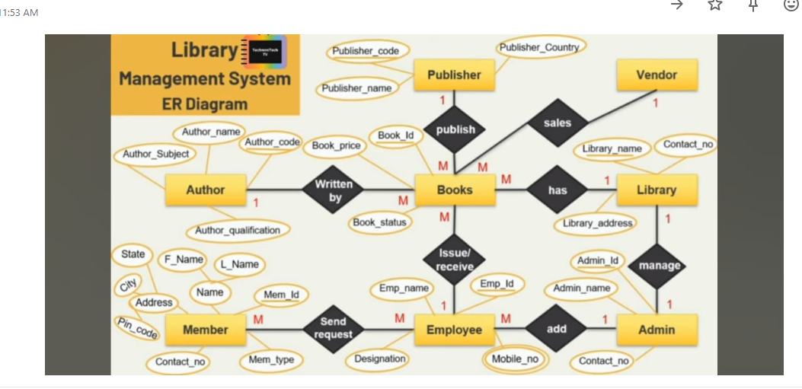
ER Diagram

Slide 4
ERD DIGRAM OVERVIEW
Entities: Author, Member, Books, Publisher, Library, Employee, Admin, Vendor
Relationships:
Author → Written by → Books
Books → Publish → Publisher
Books → Issue/receive → Employee
Employee → Add → Admin
Admin → Manage → Library
Books → Sales → Vendor
Cardinalities shown as 1:M or M:1

Slide 5
Creating Tables in Oracle (Based on ERD)
Example Tables with SQL:
✅ Author Table
CREATE TABLE Author (
Author_Id INT PRIMARY KEY,
Author_name VARCHAR(50),
Author_Subject VARCHAR(50),
Author_qualification VARCHAR(50)
);

Slide 6
Member Table
CREATE TABLE Member (
Mem_Id INT PRIMARY KEY,
F_Name VARCHAR(50),
L_Name VARCHAR(50),
Address VARCHAR(100),
City VARCHAR(50),
State VARCHAR(50),
Pin_code VARCHAR(10),
Contact_no VARCHAR(15),
Mem_type VARCHAR(20)
);

Slide 7
THEN WE ADD SIMILAR CREATE TABLE STATEMENT FOR
Books
Publisher
Employee
Admin
Library
Vendor

Slide 8
Foreign Key Relationships
Books references Author and Publisher
Member sends request to Employee
Books issued/received by Employee
Library managed by Admin
Constraints used: PRIMARY KEY, FOREIGN KEY, NOT NULL

Slide 9
Creating ERD in Oracle
Tool Used: Oracle SQL Developer or any online ERD tool
Steps:
Created all tables with primary & foreign keys.
Added relationships with correct cardinality.
Mapped attributes and entity relationships.

Slide 10
Summary
ER Diagram converted to real Oracle tables
Relationships properly maintained
Database ready for integration with OOP part
Used DBMS principles: normalization, relationships, keys

